Slide 1
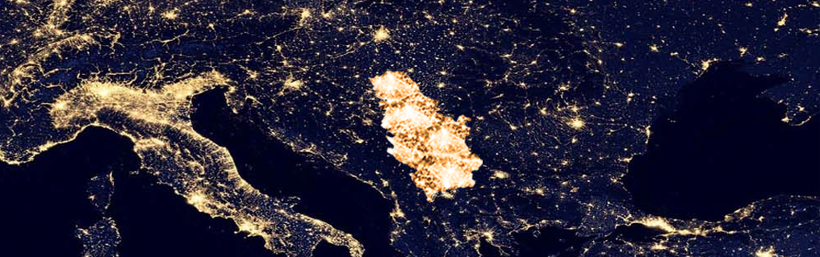

SEEPEX – Admission of exchange members
http://www.seepex-spot.com
EMS Workshop, Belgrade – 27 November 2015
Notes:
1

Slide 2
Legal and regulatory framework
    The right momentum…
    The necessary legal and regulatory changes have been implemented in Serbia to support the establishment and the smooth functioning of an organized power market:
      The Third Energy Package is enforced (new Energy Law enforced in December 2014)
      Foreign companies are entitled to directly trade on the wholesale market in Serbia since this enforcement
      The VAT law was amended and applied from October 15th. The VAT low introduce VAT representative role and set-up a reverse charge mechanism in the electricity trading
      Licensing rules have been adopted and published in Official Gazette on October 19th, and are applied from October 26th.
      Updated Custom instruction regarding cross- border electricity trading is in the process of adoption

Slide 3


SEEPEX: a pragmatic approach
    The establishment of an organized market is a logical next step in Serbia
    SEEPEX is the result of the close cooperation between EMS and EPEX SPOT
      SEEPEX is designed to be a customer-oriented company
      SEEPEX will rely on EPEX market operation (ETS)
      Clearing services will be provided by ECC according to standard model in place in other European countries
    The goal of SEEPEX is to:
      new product
      ensure a transparent and reliable wholesale price formation mechanism in Serbia
      standardized and harmonized trading and clearing rulebooks and processes
      best practice in high transparency and surveillance standards
      more effective governance and implementation of market coupling in SEE
      provide market participants with a transparent, cost-efficient and secured trading facility
      obtaining reference price in Serbia

Slide 4


SEEPEX Business Model
CLEARING HOUSE
Trading information
Settlement
Settlement Agent (for local NCM)
CLEARING MEMBER
(BANK WITH AGREEMENT
AT ECC)
Scheduling
Trading
Settlement
EXCHANGE MEMBERS
TRANSMISSION
SYSTEM OPERATOR (TSO)
Balance Responsible Agreement

Slide 5

SEEPEX Clearing Model
Local Serbian SEEPEX Trading Participants | new NCMs at ECC
  For local Serbian entities, which will have to join ECC as new NCMs, the same rules and processes will be applied towards ECC
  The CM just has to add an additional contractual partner (local Settlement Agent) for these clients to provide financial settlement
  There are currently two CMs that confirmed their selves to be ready for
  this service
Settlement Agent
CM
CM
guarantor /
payment agent
payment
NCM 1
ECC LUX
ECC LUX
Serbian NCM
delivery
ECC Clearing License covers the new product :
  All transactions will be settled in Euro – standard financial settlement procedures will apply
  It is estimated that the standard Spot Market Margin can be applied, no additional buffers are currently foreseen

Slide 6


Prerequisites to trade on SEEPEX
MRE
Licensing Rules
AERS
Issuing of License
Not necessary to register
local company in Serbia
Wholesale Supply
Supply
Company registered in
Serbia
VAT Representative
TSO
Sign a BPR contract
BRP
Transfer Balance
Responsibility to other
BRP
SEEPEX admission

Slide 7
Participation on the Serbian market
1. Strategic issue:
Decision how to participate on the Serbian market:
wholesale market
retail market
both (immediately or in the near future)
2. Regulatory issue:
Collection and submission of documents to the AERS and obtaining the appropriate license (wholesale/ supply license)
3. Legal issue:
Solve the issue of balance responsibility with EMS (sign BRP Agreement or transfer balance responsibility). BRP should provide appropriate collateral in accordance with the Market Code.
4. Admission issue (to participate on organized market SEEPEX):
Find a Clearing Member / Settlement Agent
SEEPEX KYC and documents
ECC KYC and documents
Trading agreement with SEEPEX

Slide 8
Participation on the SEEPEX
Two cases
completely new company on the Serbian market
companies already operating on the Serbian market
Having in mined that existing licenses expires 6 months after Licensing rules have been applied ( October 26th - according new Energy law Article 401).
Foreign company („mother“ company) participate at SEEPEX and Serbian („daughter“) company is BRP and responsible to nominate schedule to EMS (foreign company transfers balance responsibility to Serbian company and uses existing collateral); foreign company has to obtain Wholesale license from AERS (Serbian Regulatory Agency); existing ECC collaterals can be used.
Foreign company participate at SEEPEX and sign BRP Agreement with EMS/responsible to nominate schedule to EMS; foreign company has to obtain Wholesale license from AERS (Serbian Regulatory Agency); existing ECC collaterals can be used (for companies which are already ECC member).
Serbian local company participates at SEEPEX and uses existing BRP agreement with EMS. In this case they have to pass whole admission process with ECC; they have to find settlement agent (bank in Serbia, that has an agreement with clearing member) - at this moment there are two possibilities for clearing bank/settlement agent: Keler Ltd,Hungary/OTP Bank Serbia and Unicredit Bank/Unicredit Serbia.

Slide 9
Agreements to be signed
Trading Agreement
Non-Clearing Agreement
Balance Responsible Agreement
Between exchange member and SEEPEX
Pertains to the relationship in terms of responsability (trading, behavior on the market), requirements (technical, training of traders organization) and property (license)
Between ECC, the clearing member and the exchange member
Conclusion of a corresponding NCM agreement with the cooperating clearing member and ECC
Between the exchange member and the TSO
Includes all contractual agreements between the TSO and the grid user regarding the settlement of power imbalances recorded on balance perimeters
At least one for each market area

Slide 10






How to become a member?
Step 1: Contact us (membership@seepex-spot.rs)
Step 2: Find a clearing bank and become a balance responsible party or transfer your balance responsibility - join an existing agreement
Step 3: Fill in the ``know your customer`` questionnaire (KYC) and provide supporting documents, submit admission documents to SEEPEX and ECC
Step 4: Check of the admission documents (SEEPEX), Pass the trader exam (for non certified traders on EPEX Spot), Approval by SEEPEX and ECC
  Step 5: Technical set up of the trading system access
→ Exchange member is ready to start trading

Slide 11
Day-ahead auction with delivery on the Serbian control area
Size
The minimum volume increment is 0.1 MW.
Tick
The minimum price increment is EUR 0.1 per MWh.
Underlying
Electricity traded for delivery the following day in 24 hour intervals.
Special case:
A full 25 hour Excel template is needed when the clocks are set to winter time. Hour 3 and 3X can contain different values. When the time is switched to summer time the system automatically deletes the exceeding quantities for hour 3 (i.e. 2.00 am to 3.00 am).
Place of Delivery
Deliveries are made within the Serbian transmission system managed by EMS.
Auction hours:
24 hrs per day starting forty five days before Delivery Day, 7 days a week, year-round, including statutory holidays.
Order Book closes Daily at 10:15 am.
Publication time
The auction results are published as soon as they are available from 10:25.
Type of orders
Individual hours
Orders contain up to 256 price/quantity combinations for each hour of the following day. Prices must be between 0.0 €/MWh and 3000 €/MWh. The 254 prices are not necessarily the same for each hour. A volume – whether positive, negative or nil – must be entered at the price limits. A price-inelastic order is sent by putting the same quantity at the price limits.

Slide 12
SEEPEX price list
Entrance fees
One-off | 15 000 €
Annual fees
One day-Ahead Auction | 10 000 €
Transaction fees | Trading fee | Clearing fee (ECC)
Day-ahead auction | 0,095 €/MWh | 0,02 €/MWh
Annual technical fees
SEEPEX Trading System (ETS): 2 users and 2 portfolios |  | 8 000 €
Additional user ETS (incl. read-only) |  | 3 000 €
Additional portfolio ETS |  | 2 000 €

Slide 13

SEEPEX Regional perspective: the cornerstone of power trading between CEE & SEE
    Serbia is located at the heart of the cross-border exchanges between South Eastern Europe and Central Eastern Europe → 2 common borders with the 4MMC.
    Dynamic cross-border trading on its 8 borders with more:
      cca. 30 companies active on cross-border trading
      most of them are already admitted by EPEX SPOT and/or ECC
DAM coupled
DAM operated & coupled by EPEX
EPEX SPOT markets
PX/MO project in progress
OTC only

Slide 14

Energy will belong to everyone…
Vojvode Stepe 412
11000 Belgrade (Serbia)
Tel +381 11 715 28 43
info@seepex-spot.rs
http://www.seepex-spot.com

